Slide 1
Patent Information Initiative for Medicines Pat-INFORMED
October 30, 2019
Thomas Bombelles
Head, NGO and Industry Relations

Slide 2
What is Pat-INFORMED?
The Patent Information Initiative for Medicines, (Pat-INFORMED) is a search engine to help pharmaceutical procurement agencies determine the patent status of a medicine.
It facilitates access to and availability of pharmaceutical patent information to inform procurement decisions.
Pat-INFORMED is a partnership among WIPO, IFPMA and 20 global pharma companies.

Slide 3
Why create Pat-INFORMED?
Greater transparency of patent information on medicines.
“WIPO Development Agenda Goal 31:”… Better access to publicly available patent information…
UN Sustainable Development Goals:
Goal 3. Promote health and well-being
Goal 9. Foster innovation
Goal 17. Strengthen implementation through partnerships

Slide 4
Which therapeutic areas does Pat-INFORMED cover?
Cardiovascular diseases
Diabetes
Hepatitis C
Oncology
Respiratory conditions
HIV/ AIDS
Pat-INFORMED provides patent information for small molecules in:
All products on the WHO EML that are not within these therapy areas
→ After the launch, the database will begin to be expanded to other therapeutic areas.

Slide 5
Who can use Pat-INFORMED?
Pat-INFORMED is accessible to everybody, but it is specifically aimed at pharmaceutical procurement services and related specialists of:
International bodies and donors
National pharmaceutical services
Ministries of health
National patent offices

Slide 6
What’s in Pat-INFORMED?
20 Companies
224 INNs
+19000 Patents
+600 Patent Families

Slide 7
Who is Using Pat-INFORMED?
+4500 individual searches
Greatest number of searches (74) for sofosbuvir (Hep C)
Most products are searched for once or twice
Wide geographical distribution of users

Slide 9
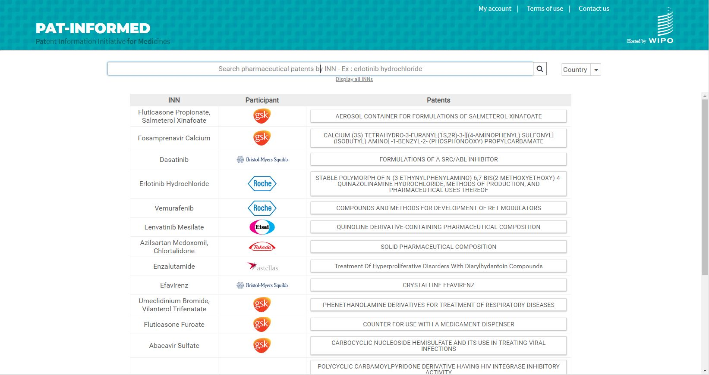

Slide 10
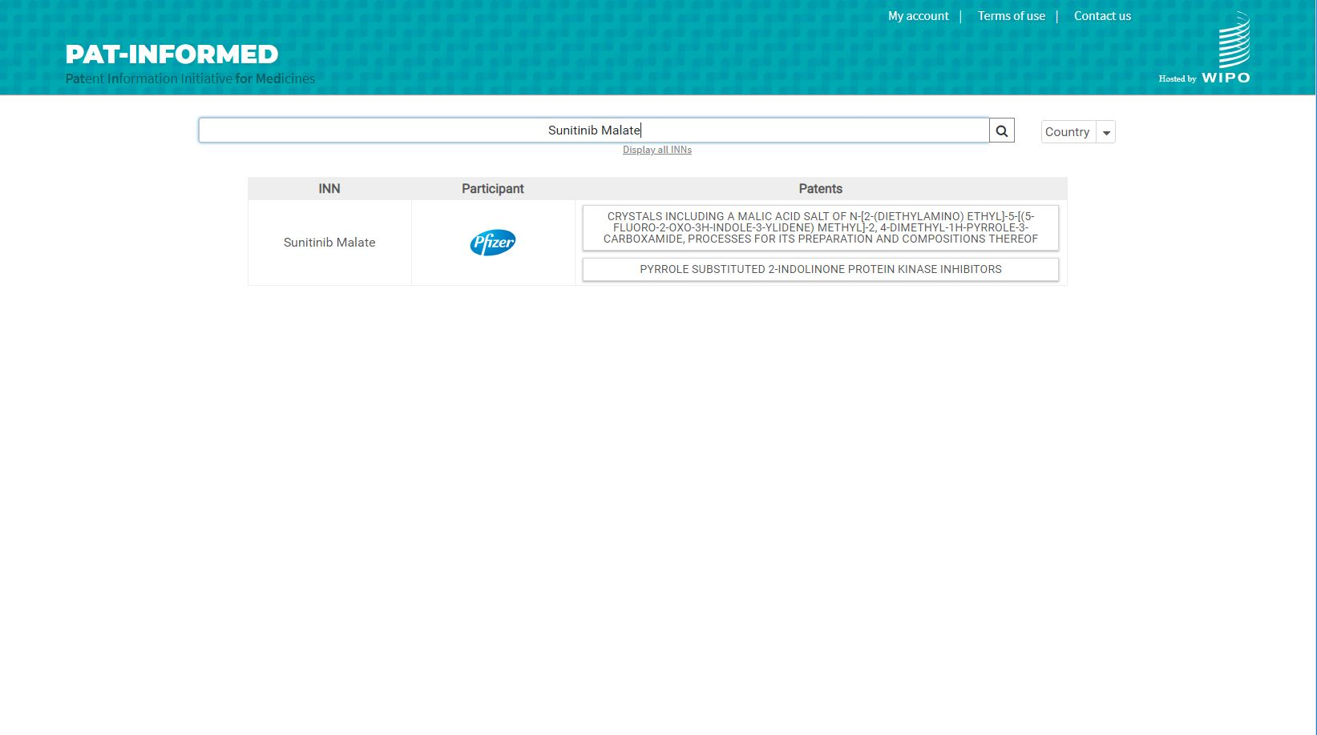

Slide 11
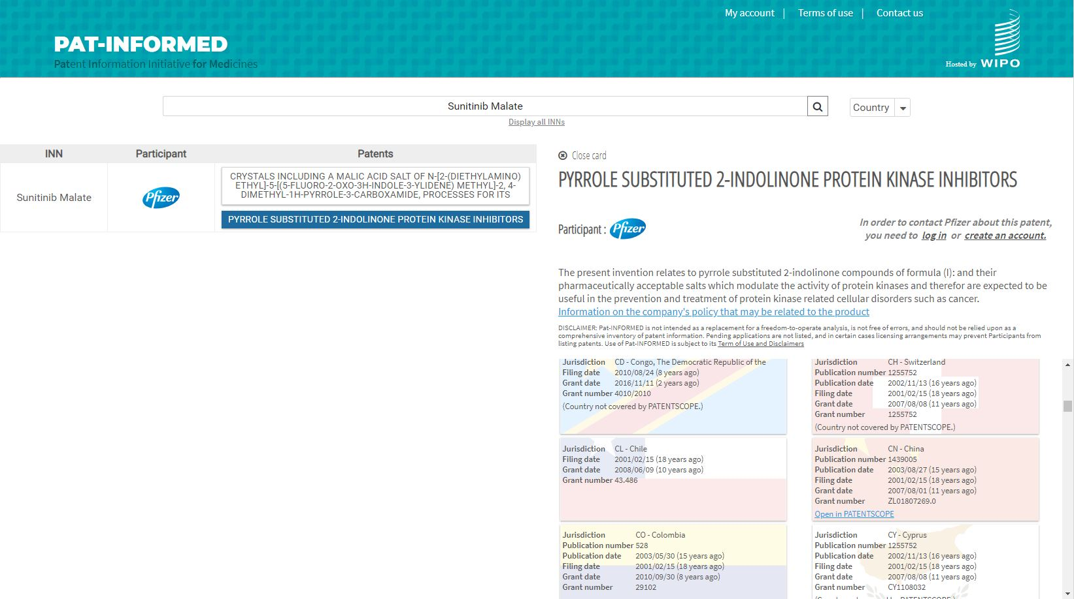

Slide 12
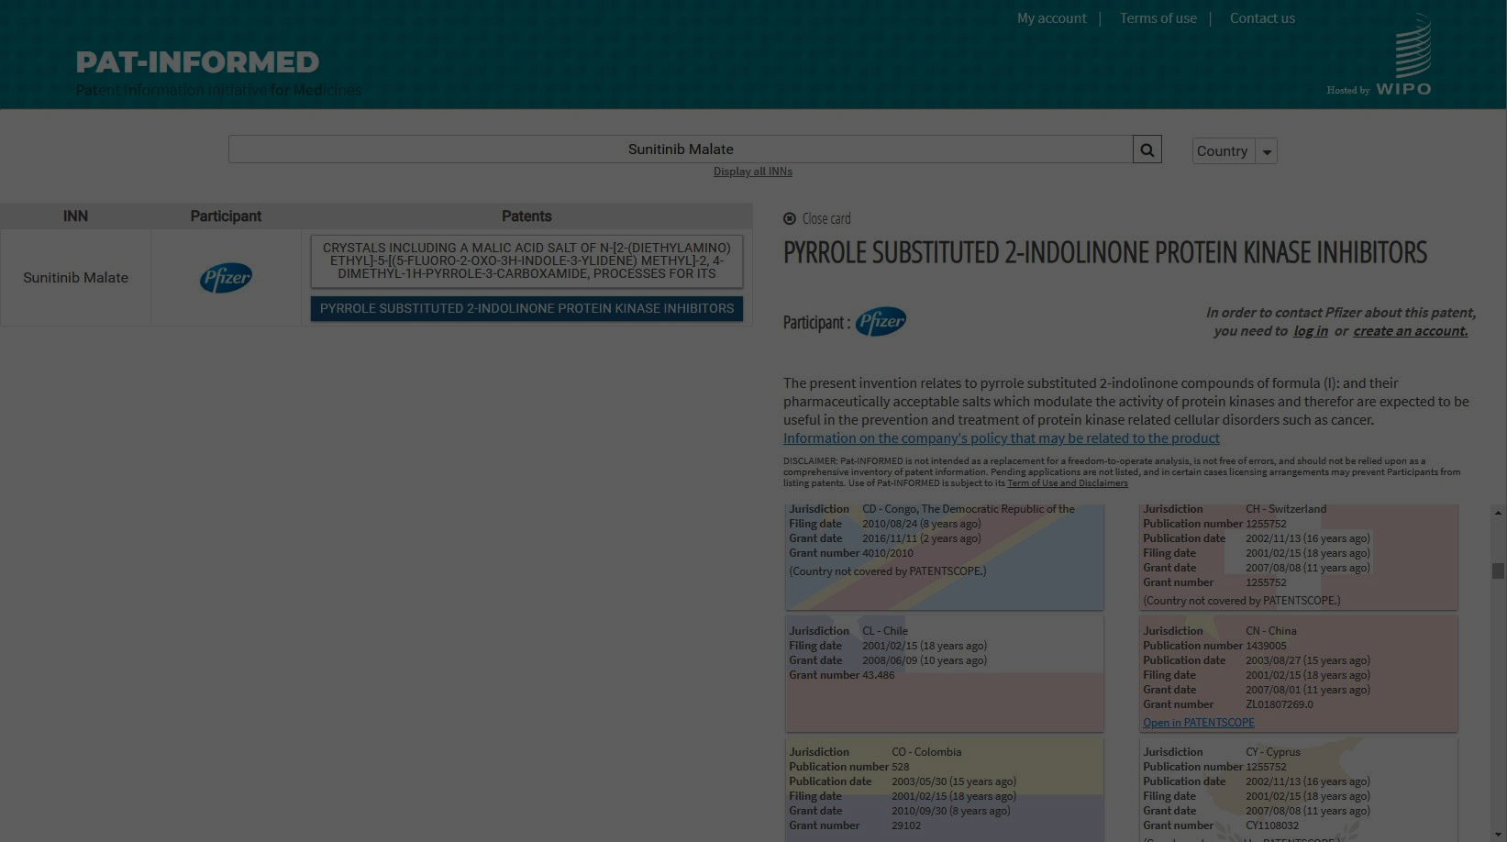
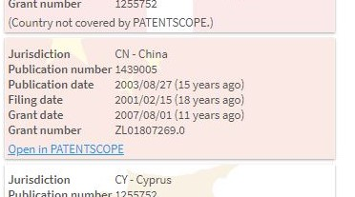

Slide 13
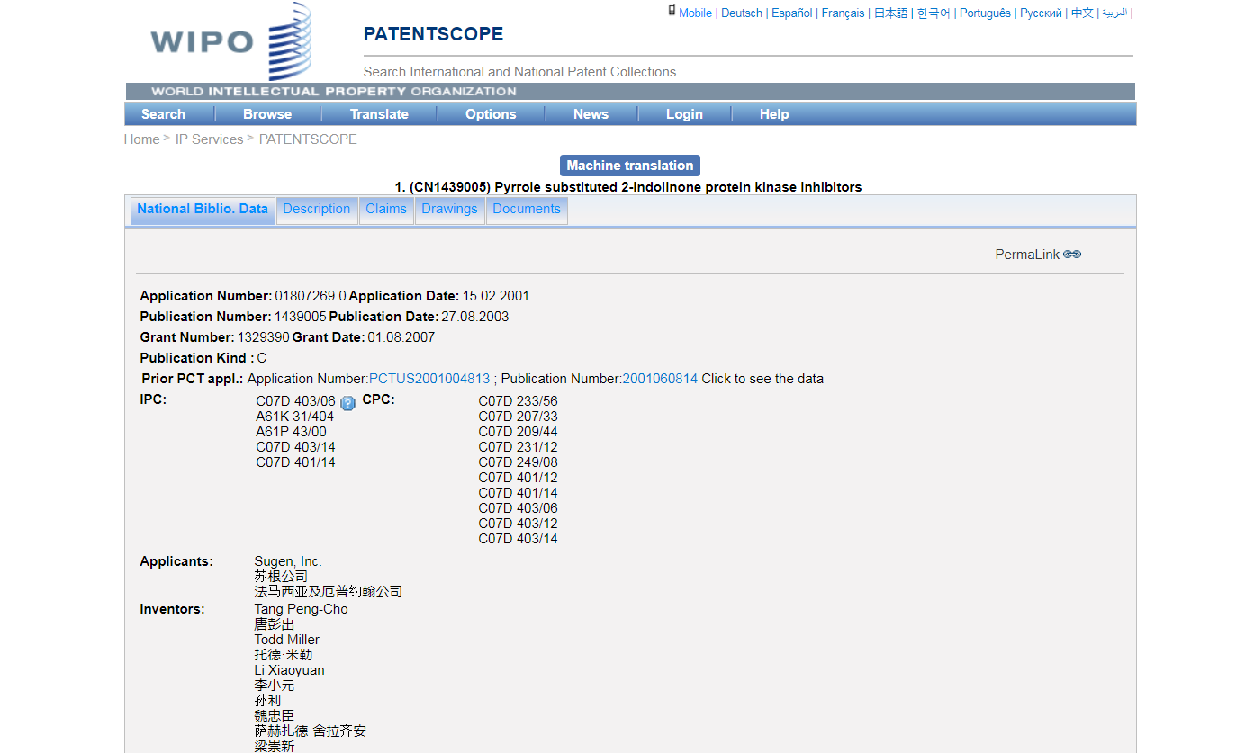

Slide 14
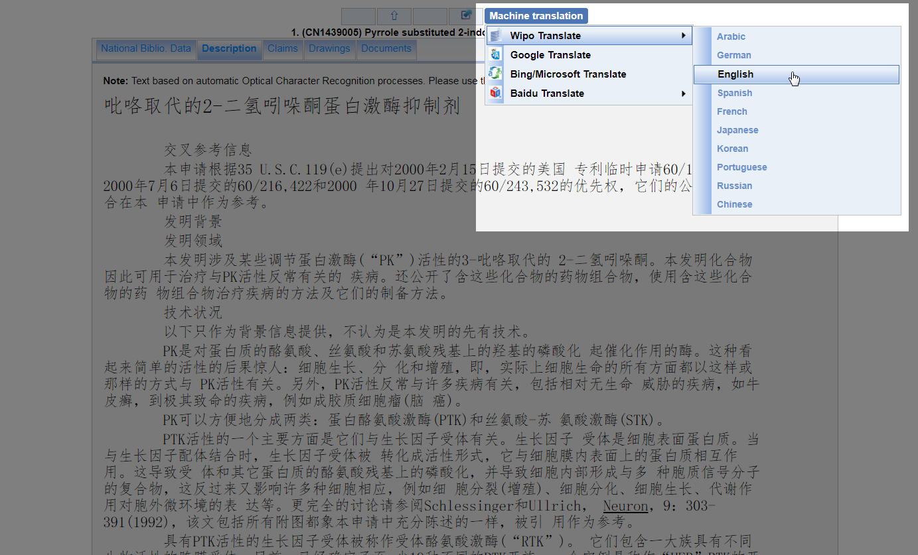

Slide 15
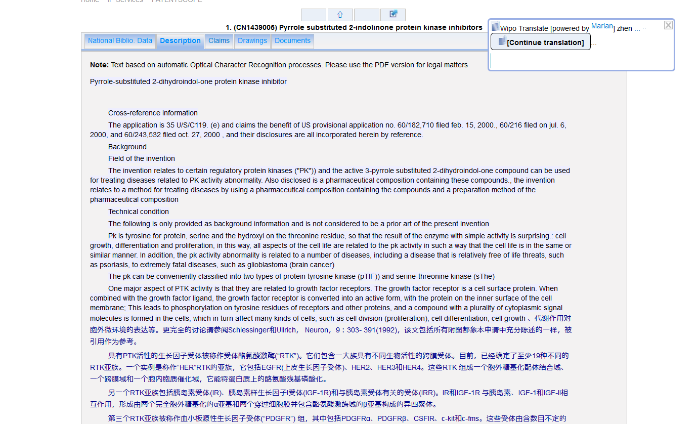

Slide 16
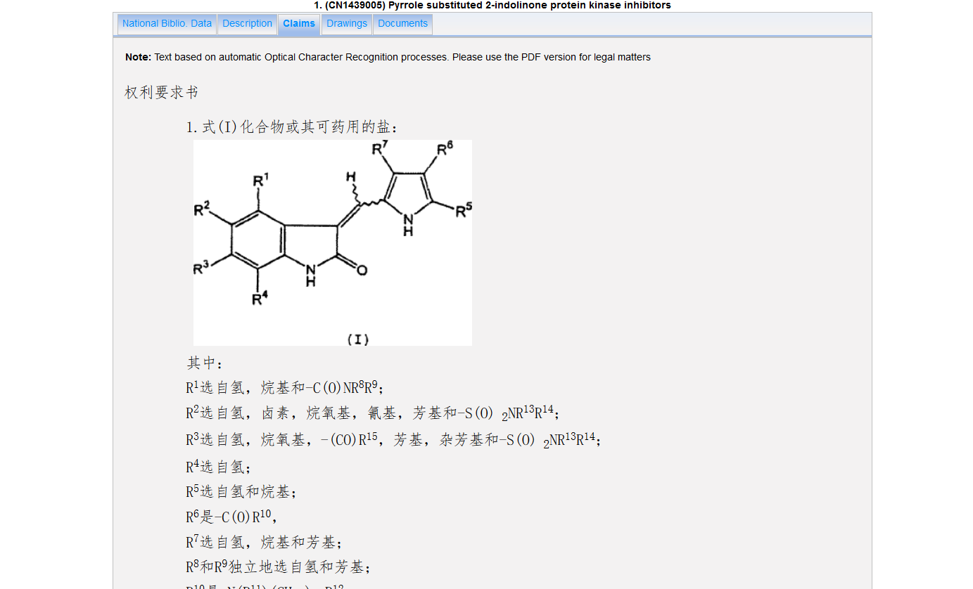

Slide 17
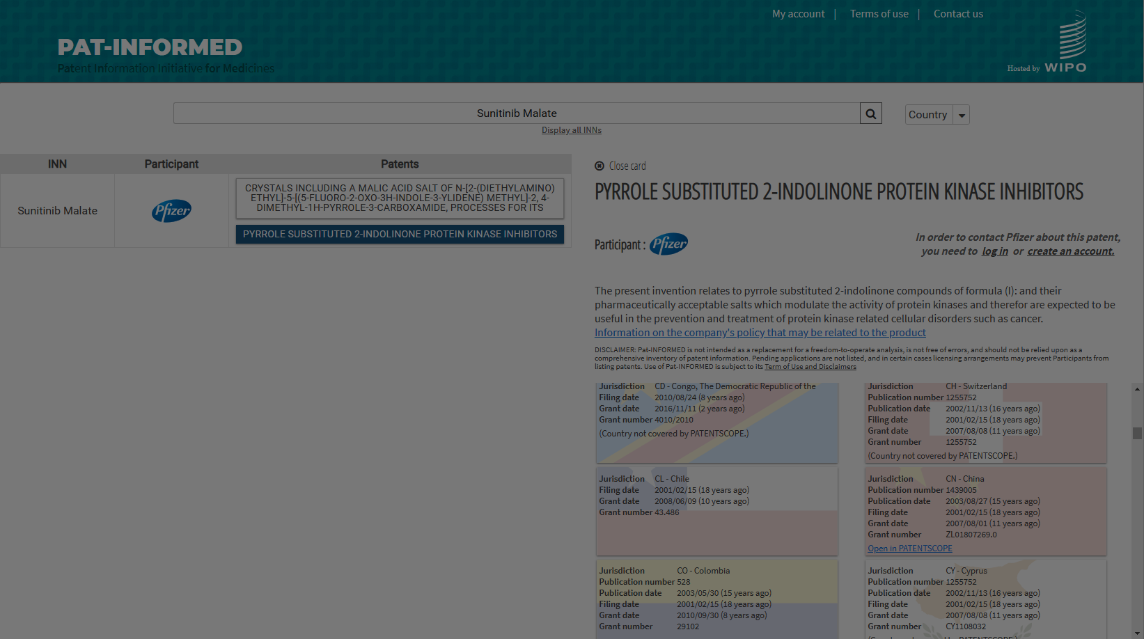

Slide 18
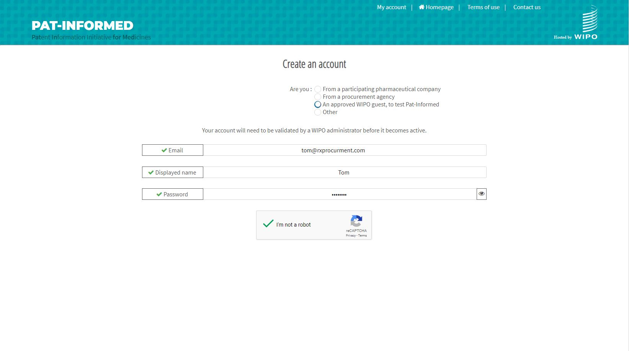

Slide 19
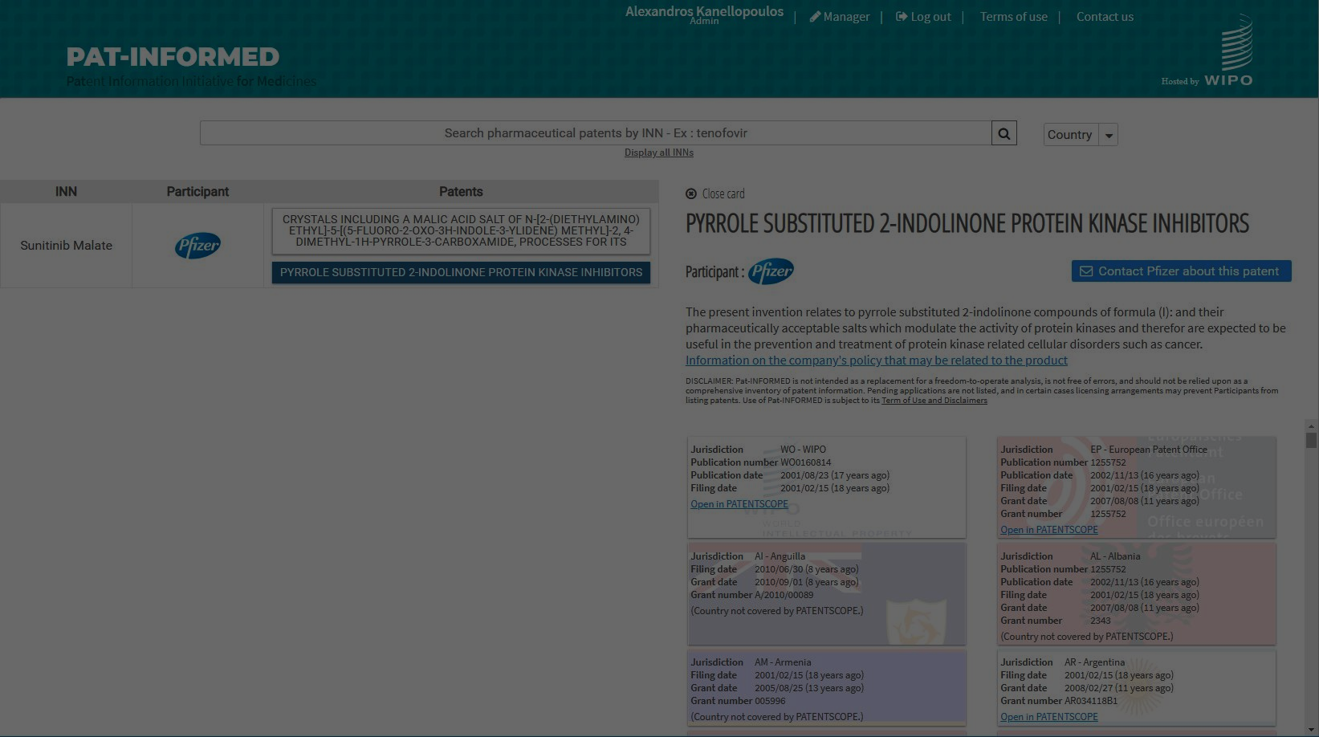

Slide 20
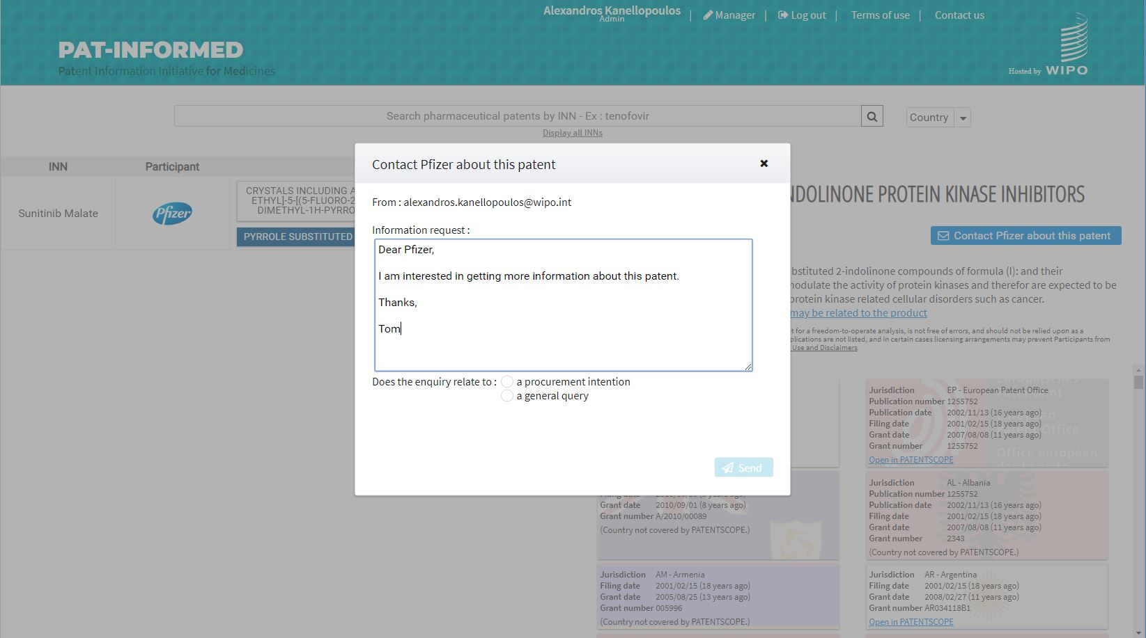

Slide 22
Pat-INFORMED limitations
While Pat-INFORMED can be an important tool in informing procurement, it has limitations
All information, including the advise received in the follow-on enquiry facility, is non-confidential. Agencies are free to challenge the information and/or seek new advice.
Public Information
No Freedom to Operate
Pat-INFORMED does not provide freedom to operate and is not part of a regulated “linkage” system.
Not Error-Free
It is a database for general information purposes and is not free of errors.

Slide 23
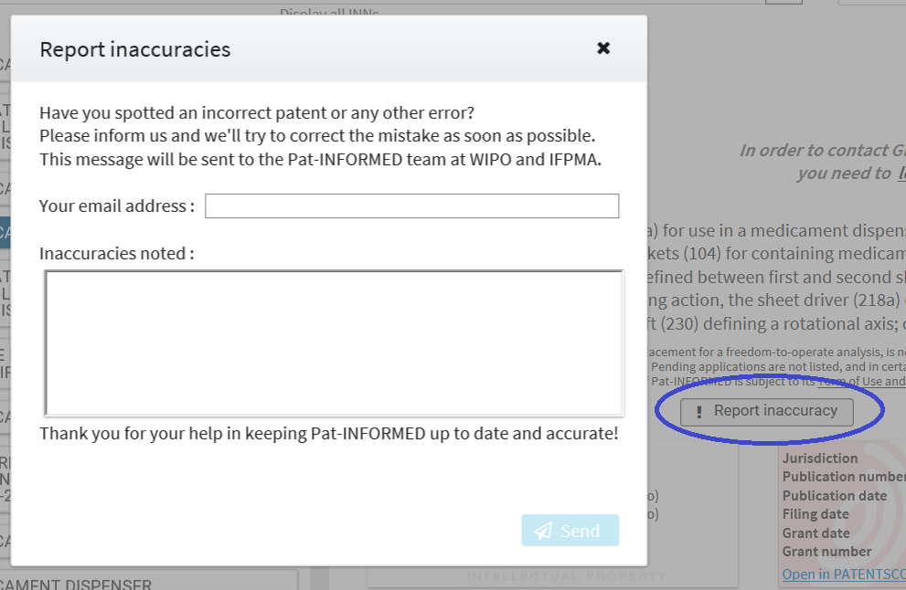

Slide 24
Thank you
For further information contact:
Thomas Bombelles
+41 22 338 82 96
thomas.bombelles@wipo.int
Guilherme Cintra
+41 22 338 32 22
g.cintra@ifpma.org

